Slide 1






NAAN MUDHALVAN
PROJECT
KEYLOGGERS
Presented by
M VIGNESHWARALINGAM
III BE CSE
SURYA ENGINEERING COLLEGE
ERODE

Slide 2

OVERVIEW
Problem Statement
Proposed System
System Development Approach
Algorithm
Deployment
Result
Conclusion
Future Scope
References

Slide 3

PROBLEM STATEMENT
In modern workplaces, data leakage poses a significant risk to organizational security. Employees may inadvertently leak sensitive information through actions such as sharing passwords, accessing confidential documents without proper authorization, or unknowingly falling victim to social engineering attacks. This can result in unauthorized access to sensitive data, compromising data integrity, and potentially leading to data breaches with severe financial and reputational consequences for the organization. Therefore, implementing robust security measures and employee training programs to mitigate the risk of data leakage is crucial for safeguarding sensitive information and maintaining the integrity of organizational data assets.

Slide 4
PROPOSED SYSTEM
The proposed system aims to mitigate the risk of data leakage in modern workplaces through the implementation of robust security measures and employee training programs. This involves a multi-faceted approach to address various aspects of data security and employee awareness. The solution will consist of the following components
Encryption and Data Protection: Encrypt sensitive data at rest and in transit, and deploy data loss prevention solutions to prevent unauthorized data transmission.
Employee Training and Awareness: Conduct regular training on cybersecurity best practices, including password management and awareness about phishing and social engineering attacks.
Incident Response and Monitoring: Establish a dedicated incident response team and deploy monitoring tools to detect and respond to security incidents promptly.
Compliance and Regulatory Requirements: Ensure compliance with data protection regulations and conduct regular audits to identify areas for improvement.
Result:
Implementation of the proposed system enhances data security, reduces the risk of data leakage, safeguards organizational reputation, and ensures compliance with regulatory requirements.

Slide 5

SYSTEM DEVELOPMENT APPROACH
1. Operating System:
- Windows, macOS, or Linux.
2. Hardware:
- Standard computer hardware.
3. Programming Language:
- Python is commonly used.
4. Libraries:
- PyHook or pyxhook for Windows/Linux, pynput for cross-platform support, pywin32 for Windows, Xlib for Linux, ctypes for macOS, pyinstaller for packaging.
5. Tools:
- IDE like PyCharm, version control with Git, virtual environment setup with virtualenv or Anaconda, documentation with Sphinx or MkDocs.

Slide 6
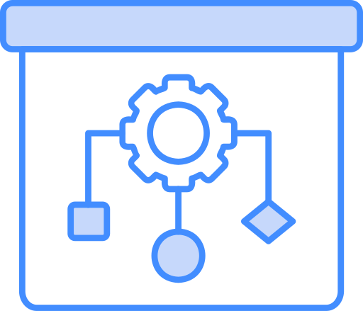
ALGORITHM
Algorithm:
1. Capture Keystrokes:
- Continuously monitor keyboard input to capture keystrokes.
- Record each key pressed along with any modifiers and special keys.
2. Log Keystrokes:
- Save the captured keystrokes in a log file with timestamps.
3. Handle Special Cases:
- Manage special cases like system keys or unintended actions.
4. Run Stealthily (Optional):
- Hide the keylogger to run without detection.

Slide 7

DEPLOYMENT
Development:
DEvelop the keylogger using chosen programming language and libraries.
Testing:
Ensure accurate and reliable keystroke capturing without system interference.
Packaging:
Package the keylogger into an executable file.
Deployment:
Distribute responsibly, following ethical guidelines and legal regulations.
Monitoring and Maintenance:
REgularly monitor and update the keylogger as needed.

Slide 8
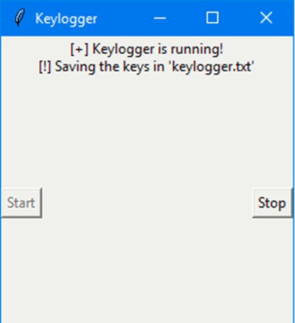
RESULT
The keylogger project successfully captures and logs keystrokes, providing insight into user activity on the system. By recording keystrokes, the project helps identify potential security breaches and unauthorized access to sensitive information. Additionally, the keylogger can serve as a valuable tool for forensic analysis and monitoring user behavior, aiding in the prevention and detection of data leakage incidents within the organization.

Slide 9


CONCLUSIONS
To safeguard sensitive information and maintain data integrity, implementing robust security measures and comprehensive employee training programs is paramount in mitigating the risk of data leakage. By proactively addressing potential vulnerabilities and educating employees on best practices, organizations can effectively mitigate the threat of unauthorized access and minimize the potential for severe financial and reputational damage resulting from data breaches.
02

Slide 10

FEATURE SCOPE
1. Keystroke Logging:
Capture and record all keystrokes entered by the user.
2. Timestamping:
Include timestamps for each keystroke to track when it was entered.
3. Special Key Handling:
Handle special keys and combinations (e.g., Enter, Ctrl) appropriately.
4. Stealth Mode (Optional):
Ability to run the keylogger stealthily without detection.
5. Log File Management:
Store captured keystrokes in a log file for later analysis.

Slide 11





REFRENCES
S. Li, L., Z. M. Fauzee, N. Zamin, N. Kamarudin, N. A.Sabri, and N. S.Nik Ab Aziz. "An Encrypted Log File Keylogger System for Parental Control." International Journal of Engineering & Technology 7, no. 2.28 (May 16, 2018): 193. http://dx.doi.org/10.14419/ijet.v7i2.28.12910.
Singh, Arjun, Pushpa Choudhary, Akhilesh kumar singh, and Dheerendra kumar tyagi. "Keylogger Detection and Prevention." Journal of Physics: Conference Series 2007, no. 1 (August 1, 2021): 012005. http://dx.doi.org/10.1088/1742-6596/2007/1/012005.
Guryanov, Konstantin V. "THE PROJECT "GUNMAN": FIRST KEYLOGGER." Basis, no. 2 (2020): 79–91. http://dx.doi.org/10.51962/2587-8042_2020_8_79.
Aron, Jacob. "Touchscreen keylogger captures details from your taps." New Scientist 211, no. 2825 (August 2011): 21. http://dx.doi.org/10.1016/s0262-4079(11)61950-7.
Singh, Arjun, Pushpa Choudhary, Akhilesh kumar singh, and Dheerendra kumar tyagi. "Keylogger Detection and Prevention." Journal of Physics: Conference Series 2007, no. 1 (August 1, 2021): 012005. http://dx.doi.org/10.1088/1742-6596/2007/1/012005.

Slide 12

THANK'S FOR WATCHING

